Slide 1
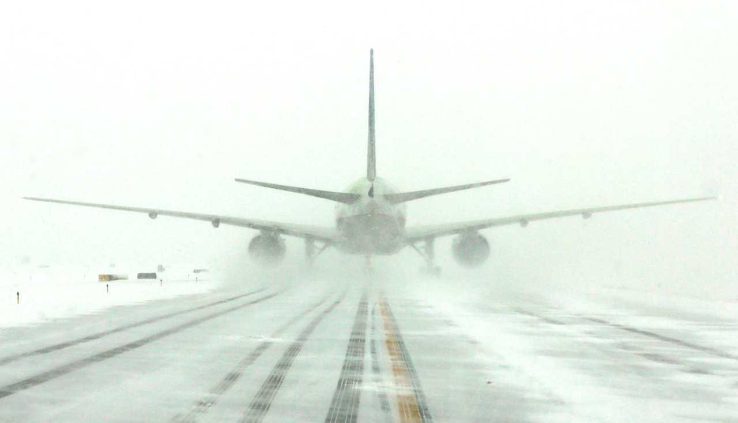

Airline Delays and Cancellations
Team 13 Definitely Vibrant
Spencer Allgaier
Leland Bolleter
Thuy Dinh
Eleibny Feliz Santana
Notes:
Hi, my name is Thuy Dinh and I’ll be introducing the Project for team 13 AKA Definitely Vibrant. Our group will be presenting on our topic of Airline delays and cancelations
I will start by presenting our topic, business justification, and data overview.

Slide 2
Research Question
Initial Problem :
How can past weather delays associated with an airport location or season be used to mitigate future flight delays?
Expanding the Topic:
What impact do flight delays have on Airlines Financials?
Focus on market cap, stock value, revenue, gross profit, and net income
Carrier delays, weather delays, National Airspace System delays, late arrival
Impact of COVID on the industry and current market
Hypothesis: Increased delays have a negative relationship to Airline financials.
Notes:
THUY: When deciding on the research area, we were curious about flight schedules and the impact of inclement weather on flight operations.
As we dove into our preliminary exploratory data analysis during the finance module of the course, we became more interested in the financial impact that delays inflict on an airline's portfolio. Our group decided to pivot from our initial question in order to capture the financial impact that delays in general incur on the airline business. In conducting this analysis, we will also take into account the dramatic changes that were brought to the industry as a whole from the global pandemic to isolate them from our research question.
We believe this better aligns with the objective of the course: "to use the scientific process of transforming data to develop insights for making better business decisions.“
Our hypothesis is that Increased delays have a negative relationship to Airline financials because it leads to increase operations cost. These cost vary from losses in customer loyalty, operational efficiency and customer compensation.

Slide 3
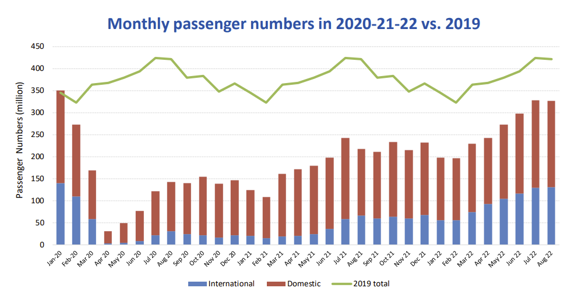
Business Justification/ Literature Review
In 2021, the cost of direct aircraft operation is approximately $80.50 per minute -- 8.4% increase compared to 2019. [3]
Estimated cost of delays in 2018 ~ 28 billion in direct cost. [4]
Delays vary between Airports and season. Historically between 15% -25%.
In 2020, the airline industry saw a 60% decrease total passengers accounting for a 324 Billion dollar loss. [5]
Currently seeing a 27% reduction compared to 2019.
Notes:
THUY: It cost airlines approximately 80 dollars a minute to operate a commercial flight and with the rising rate of inflation and labor they are only expected to get higher. One area of focus to get those costs down is to reduce delays which cost the airline industry 28 billion dollars in 2018 alone.
Overall, airport delays typically vary between 15% -25% of all incoming flights depending on the efficiency of the airport and variations in travel seasons.
The biggest disrupter to the airline industry was the Covid pandemic. According to the international civil aviation organization, Airlines saw a steep 60% drop in domestic and international flyers. This amounted to approximately 324 Billion dollars in losses.

Slide 4
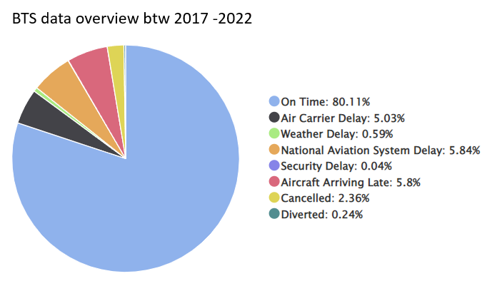
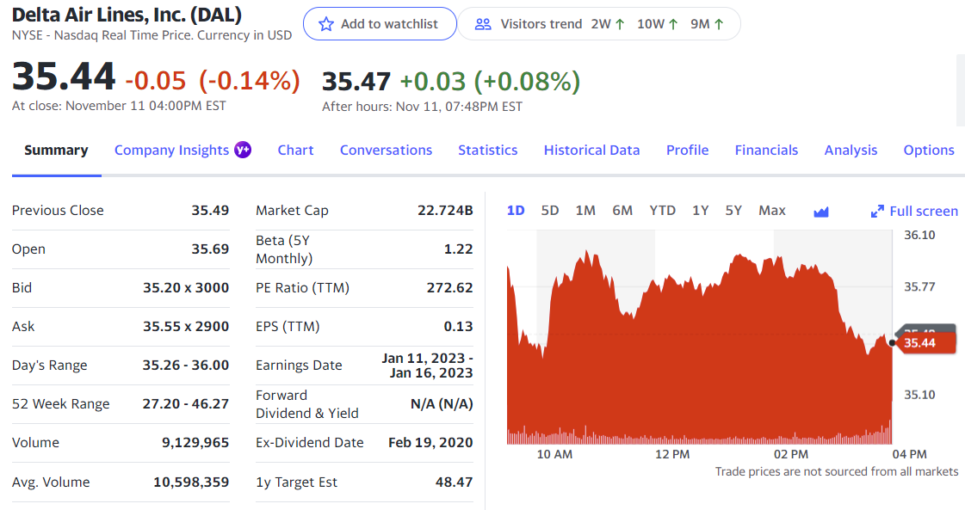
Data Overview
Focus on Top 3 Airlines
United (14.62 B), Delta (22.72B), Southwest (22.78 B)
Delay information was collected from Bureau of Transportation statistics
Financial Data was collected from Yahoo Finance and macrotrends.net
Notes:
Thuy: For the initial analysis we focus on the 3 airlines with the largest market cap. United and Delta are large carriers that focus heavily on acquiring business customers while Southwest is known to be more of an economical airline focused the consumer market.
All of our flight data comes from the bureau of transportation statistics. It has a wealth of information on carriers, flights, and airports. But as you can see here it can be broken down further into types of delays
Our financial data comes form Yahoo Finance, Market Cap and Stock Value are available on a monthly basis, while Revenue, Gross Profit and Net Income are only available on a quarterly basis.
For Covid, we define all dates prior to march 2020 as pre covid onset and all dates afterwards a post covid onset. This day was chosen because it was the period where covid was deemed a national emergency and the stock market crashed from overwhelming uncertainty.

Slide 5
Identify the Problem
Relevant Response & Exploratory Variables
Collect & Clean Data
Methodology
Source: BTS & Yahoo Finance
Remove unnecessary variables
Logical aggregation and joining
Data Exploration
Summarize data
Reveal relationships and identify potential models
Scatter plots / Box Plots
Develop Models
Total Delays ~ Revenue + Net Income + Gross Profit
Gross Profit (Linear, Log Linear and Box cox transformation)
Market Cap to flight numbers
Stock Value to delay types
Model Validation & Refinement
VIF
Residual analysis to assess assumptions
Box Cox transformation for find ideal lambda’
Outlier removal
Draw Conclusion
Analyze results and evaluate Hypothesis
Notes:
Spencer: Our methodology is as follows ….. From our data exploration we decided to focus on …… We then applied a few model refinement techniques a to reveal … aobut out models.

Slide 6
Exploratory Data Analysis
Data Cleaning:
Merge all 3 Airlines flight data together
Data cleaning to eliminate unwanted variables and manage zero values
Identify and eliminate Alias columns
Aggregated Flight data based on Monthly/ Quarterly Values
Joined Flight Data with Financial Data
Exploratory data analysis
Notes:
Spencer:

Slide 7
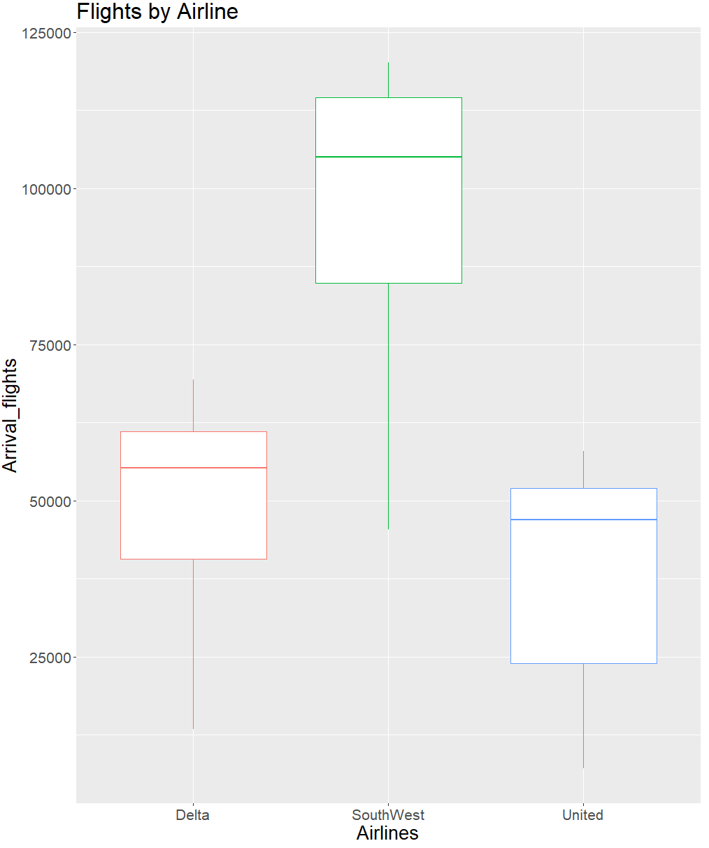
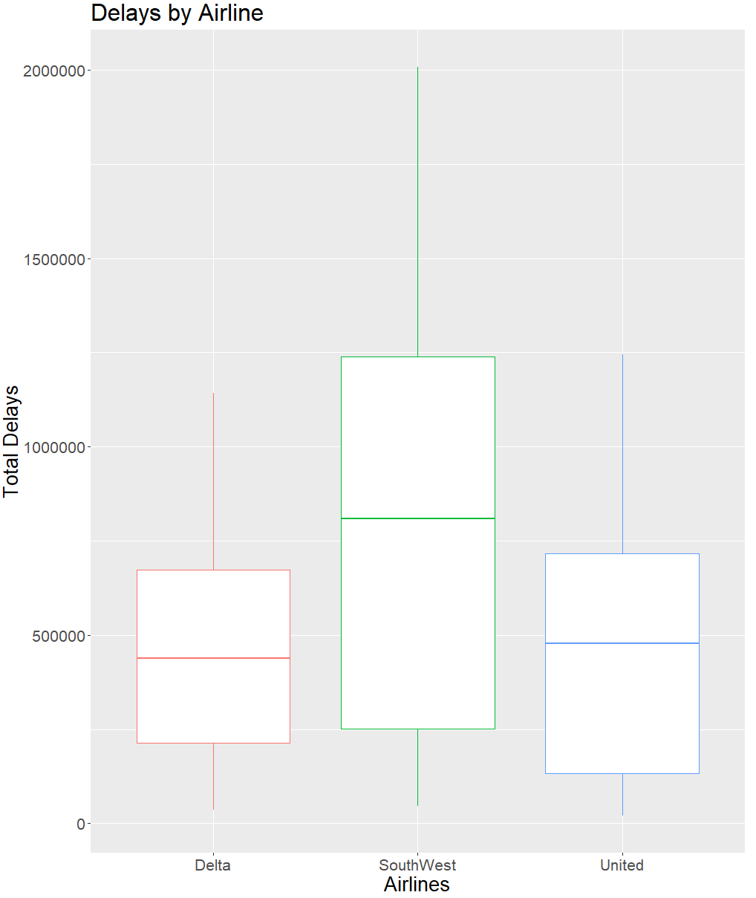
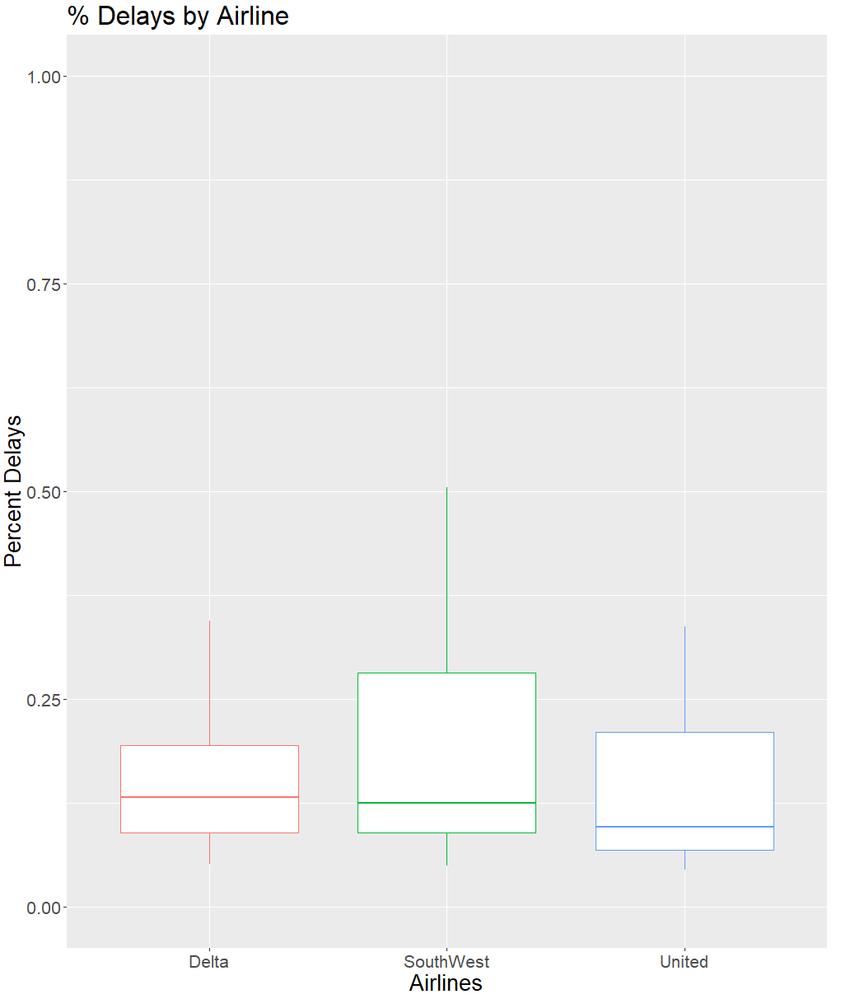

Exploratory Data Analysis
Notes:
SPENCER: Analysis was performed to determine the difference in traffic between airlines. It shows here that SouthWest had significantly higher traffic during the explored time frame. This was not a full picture of however, as it only captures the view of the top 40 busiest airports in the United States and both Delta and United have a much larger presence internationally. Understandably, SouthWest also had a higher count of delays as well. However when broken down into percentage, percent delays were relatively standard across the board. At approximately 20%

Slide 8
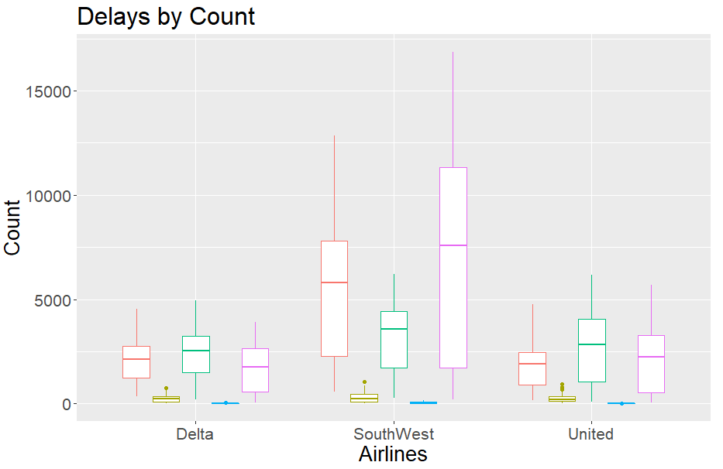
Exploratory Data Analysis
Notes:
SPENCER: To analyze which type of delays may have the greatest impact, a box plot was created which each type of delay between carries. Carrier delays, National Airspace System delays and late aircraft were the largest contributors to delay issues and security delays and weather delays have minimal effect comparatively. Delta and united tends to struggle with NAS delays where as SW has the biggest issues with late aircrafts.

Slide 9
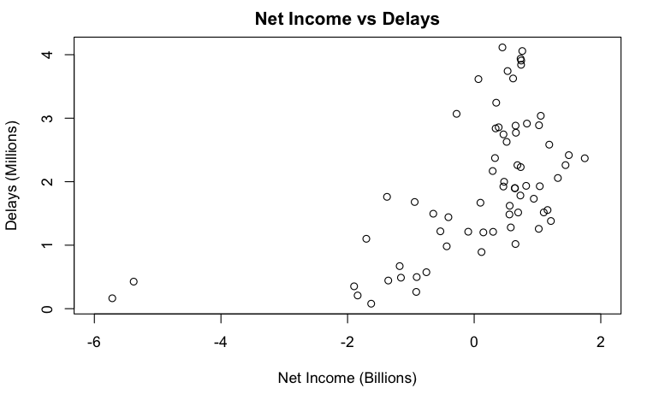
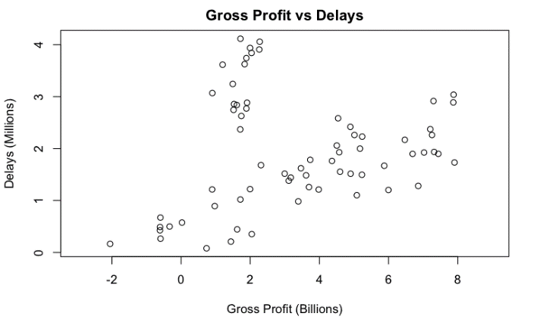
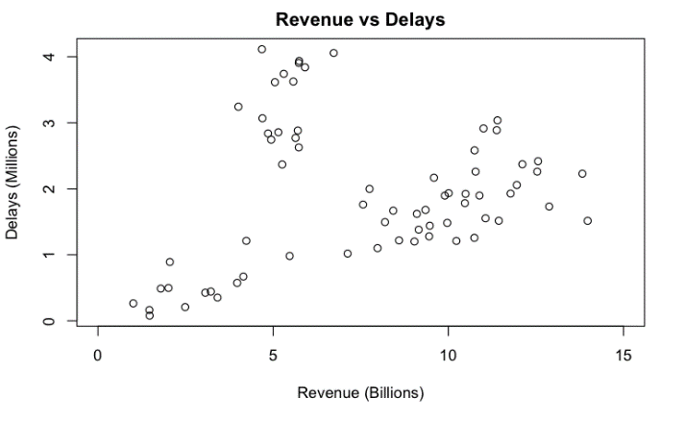
Model 1: How do delays affect financial performance
Notes:
SPENCER:

Slide 10
Model 1: How do delays affect financial performance
Notes:
SPENCER: These two outlier points in the Net Income are from Delta in Q2 and Q3 of 2020, just as the pandemic hit. Since they are

Slide 11
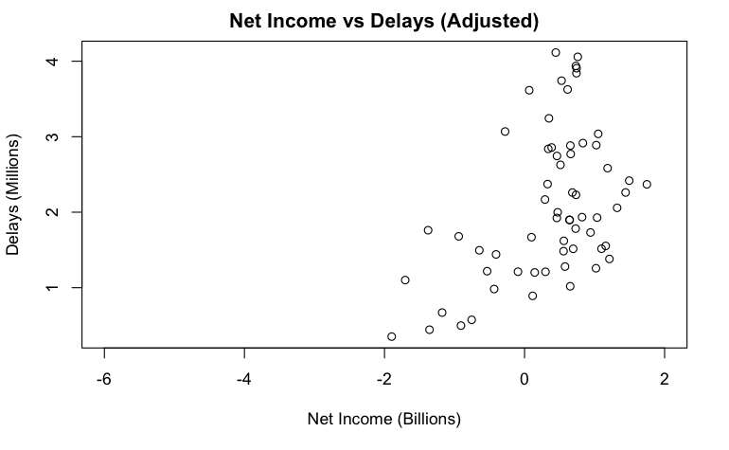
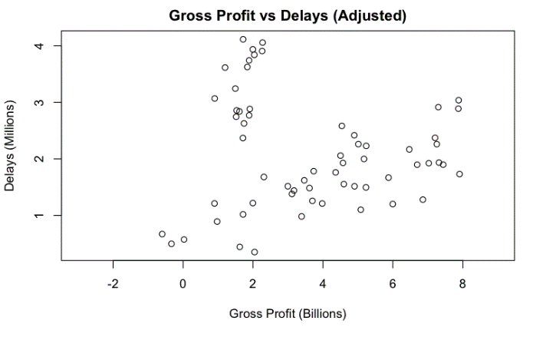
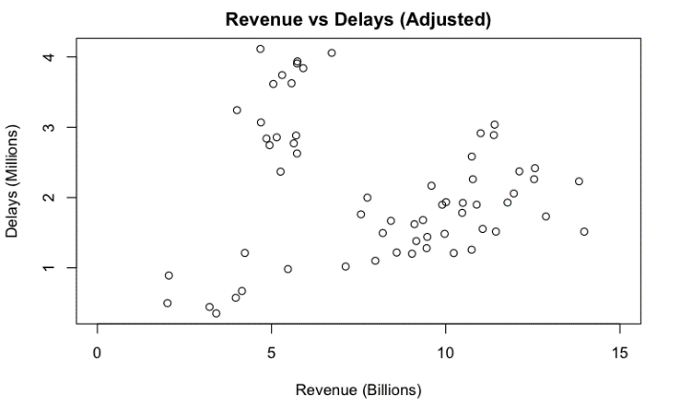
Model 1: How do delays affect financial performance
Notes:
SPENCER: Discounting the two outliers in Net Income, we can see some linear correlation between delays and the three financial values for the same quarter. However, they are POSITIVELY correlated, which is contrary to our assumption that delays would negatively affect a company’s finances. Since this is inclusive of pre-covid and post-covid, it may be misleading, so we then applied covid blocking before executing our linear model.

Slide 12
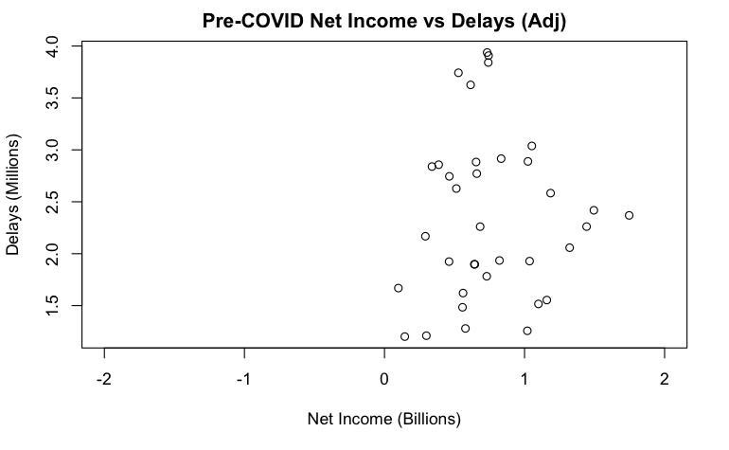
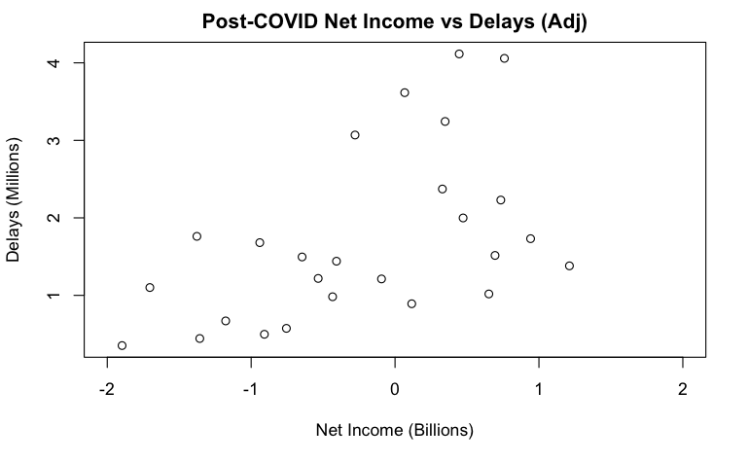
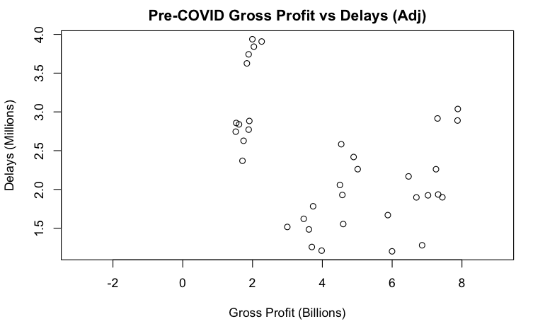
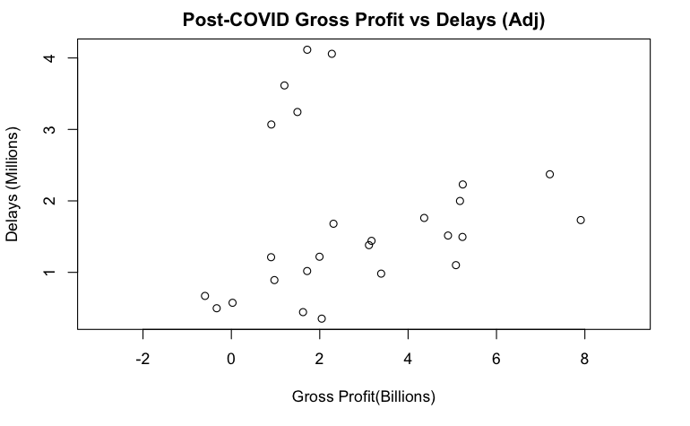
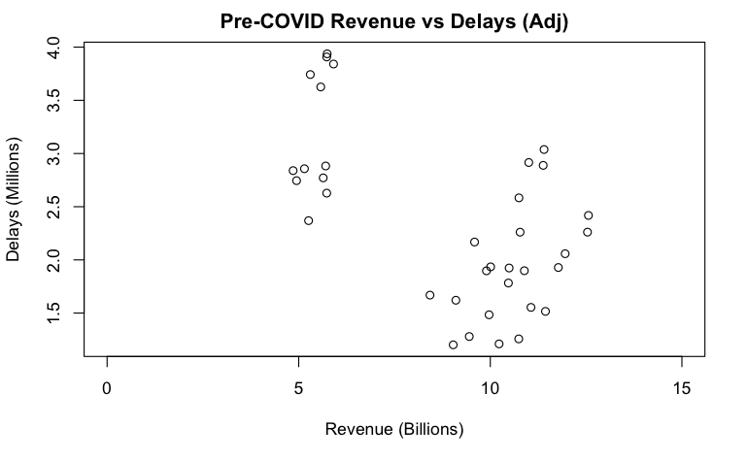
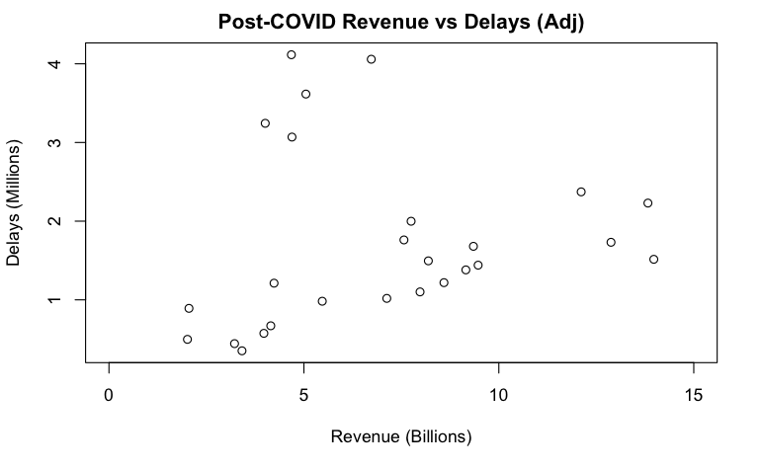
Model 1: How do delays affect financial performance
Notes:
SPENCER: Applying the blocking, we can see that the data becomes even more obscure and there is little to no conclusions to be made on financial performance based solely on delays from the same quarter. Note that the axis are fixed between plot pairs.

Slide 13
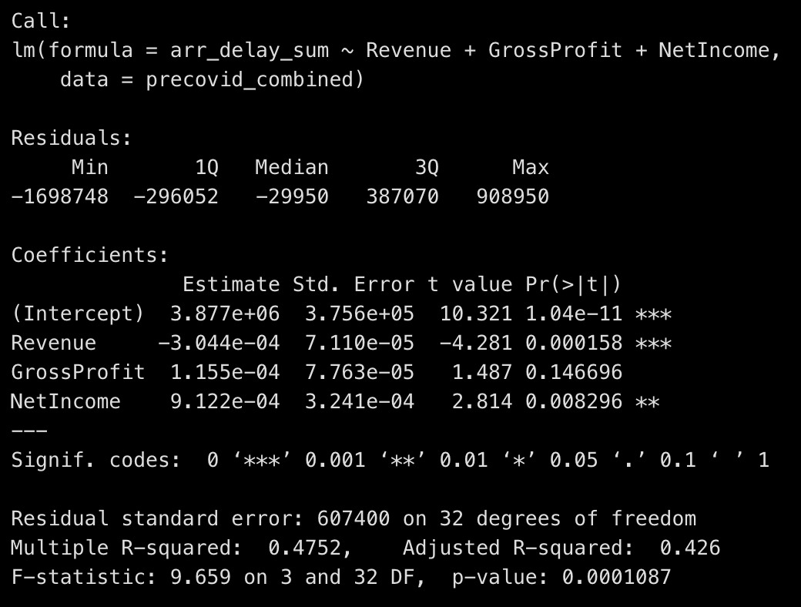
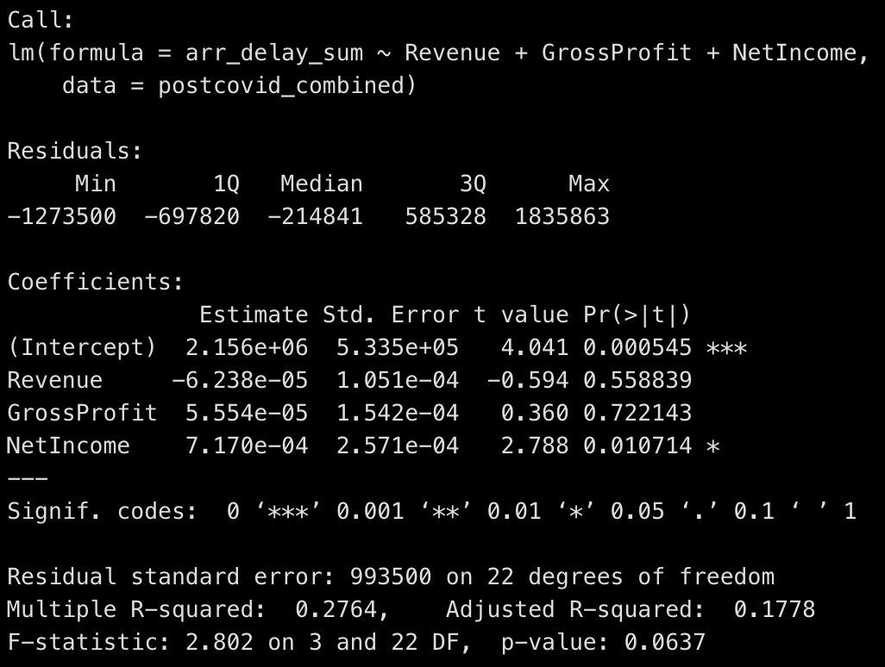
Model 1: Delays = Revenue + Gross Profit + Net Income
Notes:
SPENCER: As we run our model to prove this relationship, we confirm that this data shows little predictive power between revenue and gross profit on total delays within the same quarter. There is a significantly positive relationship between net income, which accounts for taxes and other non-operational expenses, even when blocking for covid dates.

Slide 14
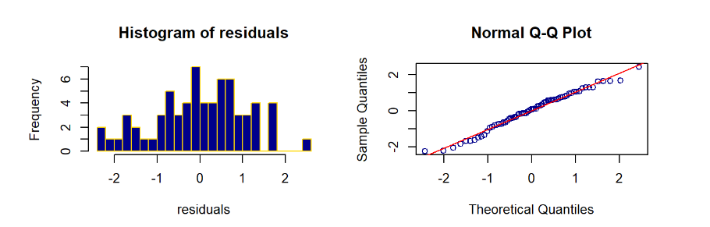
Model 2: Linear Regression Analysis for Gross Profit
1) Linear Model:
Methodology: Multiple regression
Analysis: Assumptions evaluation using residual Analysis
Results
As the plots show, Linearity does not appear to hold for this model.
Notes:
Hi,
I am Eleibny and I will be presenting the regression analysis of weather and airlines gross profit data.
For this analysis we combined the weather and gross profit data for years 2017 to 2022.
It includes Delta, United and Southwest airline.
We use 3 methods for this analysis:
Linear regression, Log-Linear and for the last model, we used the Box Cox technique to determine the optimal lambda for transforming the response.
Before fitting the models on the data, we performed data cleaning and exploratory data analysis.
The data was aggregated to quarters and merged. And then we use Scatterplots and Box Plots to analyze the relationship between predictor and response.
Additionally, we eliminated alias variables that would contribute to multicollinearity.
On the first model, we use multiple regression.
To assess the model, we use residual analysis to evaluate the assumptions.
In the slide we can see a histogram and a qqplot. In a good model, we expect to see a normal distribution with a bell shape that is symmetric around the mean. In this plot we can see that there is a departure from normality. This means that the model is not a good fit for the data.

Slide 15
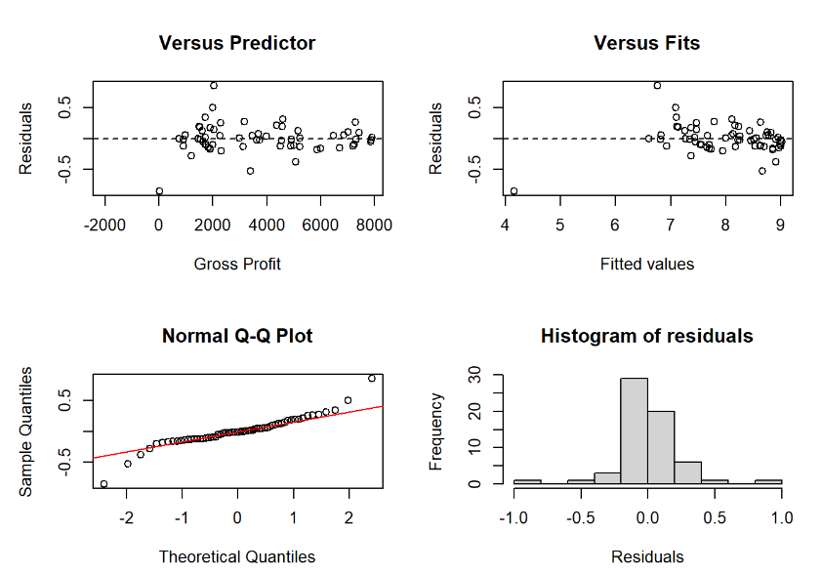
Model 2: Linear Regression Analysis for Gross Profit
2) Log-Linear Model:
Methodology: (Log Linear) Multiple regression
Analysis: Assumptions evaluation using residual Analysis
Results
From the plots, we see clusters of residuals, heavy tails and residuals not equally distributed. The assumptions do not hold for this model either
Notes:
For the second model, we transform the response using the LOG function.
We see some improvements in terms of Normality, We now see a single peak on the histogram.
The distribution, however, is not symmetric.
In terms of Constant variance and Linearity, reflected on the top plots, we observe clusters of data. The residuals are not equally or randomly distributed around the zero line, indicating that this model is not a good fit for the data.

Slide 16
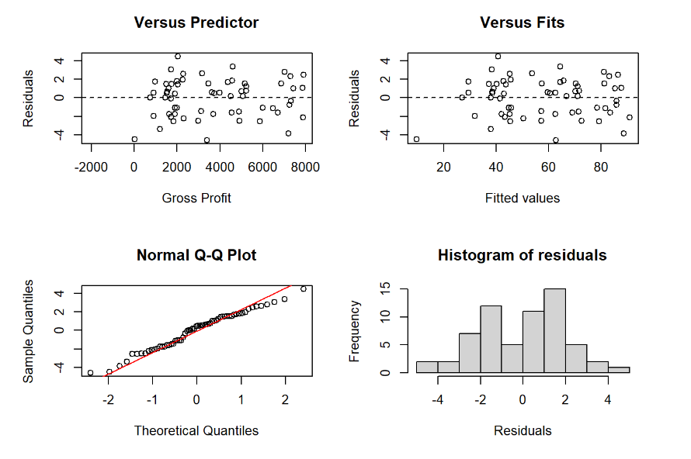
Model 2a: Linear Regression Analysis for Gross Profit
3) SQRT Box Cox:
Methodology: SQRT transformation after using Box Cox
Analysis: Assumptions evaluation using residual Analysis
Results
From the plots, we see clusters of residuals, heavy tails and residuals not equally distributed. The assumptions do not hold for this model either, especially the Linearity assumption
Notes:
When the Normality or constant variance assumptions do not hold, we often we use a transformation that normalizes or stabilizes the response variable. We used the Box Cox technique to determine the ideal Lambda. In this case, we are using the SQRT function to transform the response and fit a new model and proceed with the residual analysis to evaluate the assumptions.
We observe that the transformation has definitively improved the 3rd model. However we can see that the Normality assumption is still violated.
The implication of the Normality assumption violation is that the uncertainty in predicting the Gross Profit would be higher than estimated using this model.
The model might not contain as many significant factors to accurately predict Gross Profit.
Thus we conclude that weather delays alone does not statistically affect airlines Gross Profit.

Slide 17
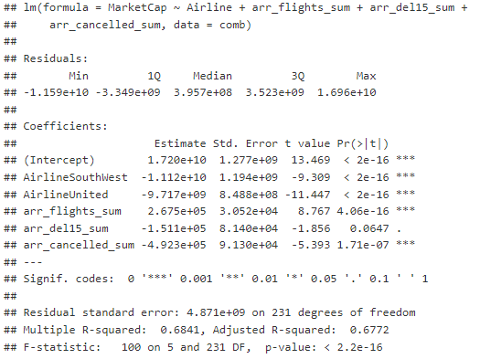
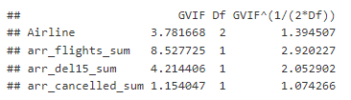
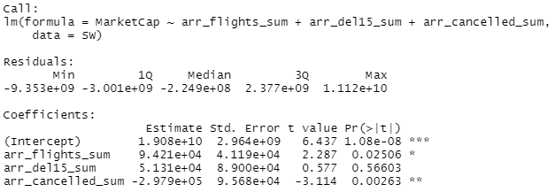
Model 3: Delays impact on Market Cap
All Airlines
SouthWest
Notes:
ELEIBNY: In Model 3 we looked at Delays impact on Market Cap. We initially looked at an overview model which modeled market cap against, total flights, total delays, and total cancelation. IT was noted that delays were only significant at a 90% confidence interval. After running more detailed models on individual airlines, we noticed that delays were not significant at all and the intercept has a positive effect on Market cap. This led us to run follow up investigation and noted in our VIF model that there was significant correlation between total number of flights and number of delays. This linear model has multi collinearity.

Slide 18
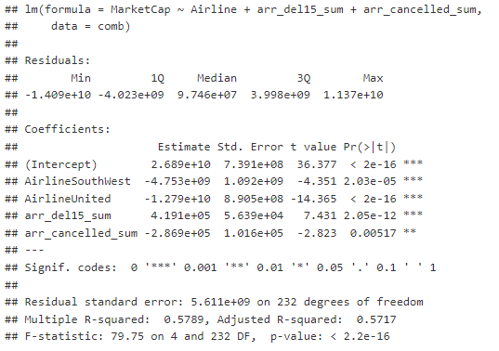
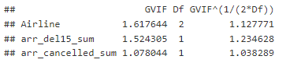
Model 3: Delays impact on Market Cap
Notes:
ELEIBNY: Based on the VIF results, we should not run the analysis using both total flights and total delays, so we removed total flights which led us to see a significantly improved VIF. From these results it seems that delays have a positive impact on Market Cap.

Slide 19
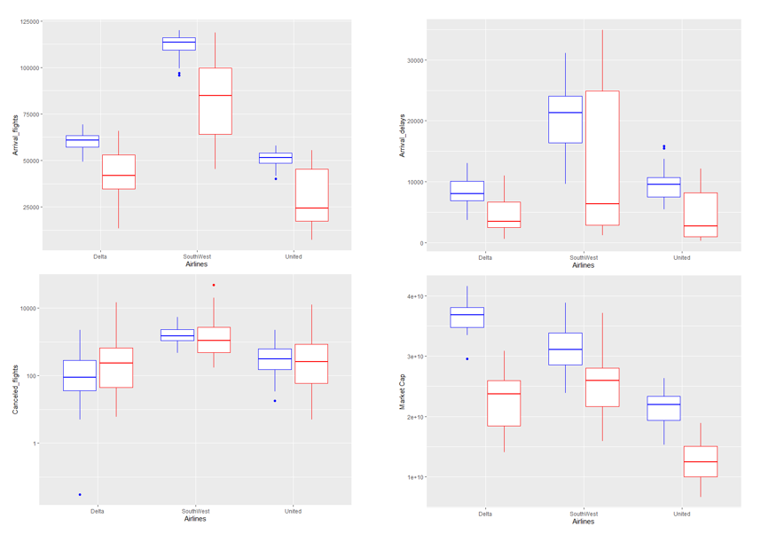
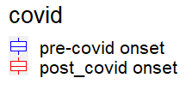
Model 3: Market Cap and Covid
Notes:
ELEIBNY: We also looked at covids impact on Market cap. As you can see, There was a significant decrease in arrival flights as consumers reduce unnecessary travel which also lead to a decrease in delays. These changes equated to a difference of 9.6B, 4.4B and 6.2B average losses for Delta, Sw and United respectively.

Slide 20
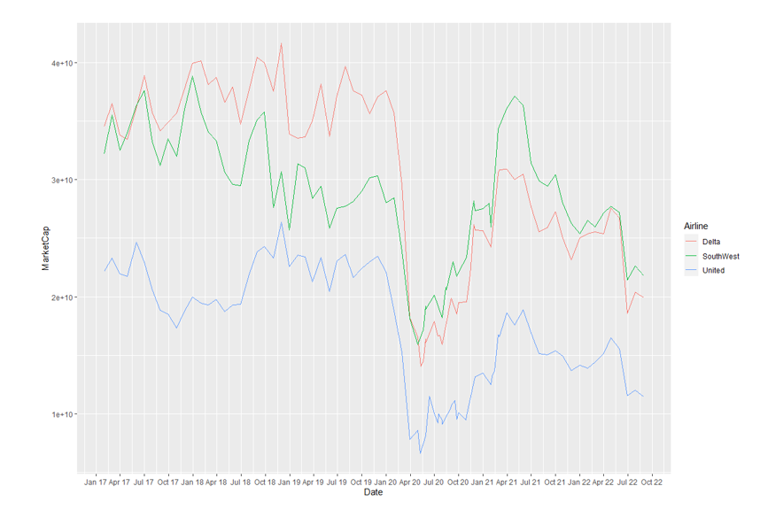
Model 3: Market Cap and Covid
Notes:
ELEIBNY: In this Line chart, we can observe the drop as the market crashed in March of 2020. As vaccinations became available flight travel increased in summer of 2021. It makes sense that SW would have an easier time bouncing back as they focus on affordable domestic travel where as Business and international travel are still down ~25% which is a significant protiopn of delta and united customer base.

Slide 21
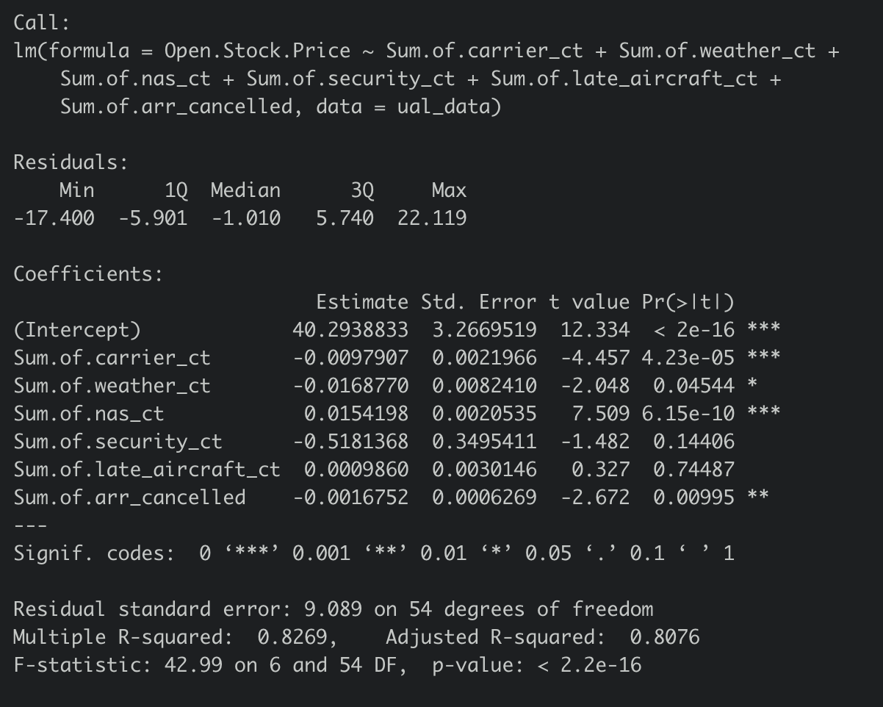
Model 4: Stock Prices and Airline Delays
Notes:
Notes inline

Slide 22
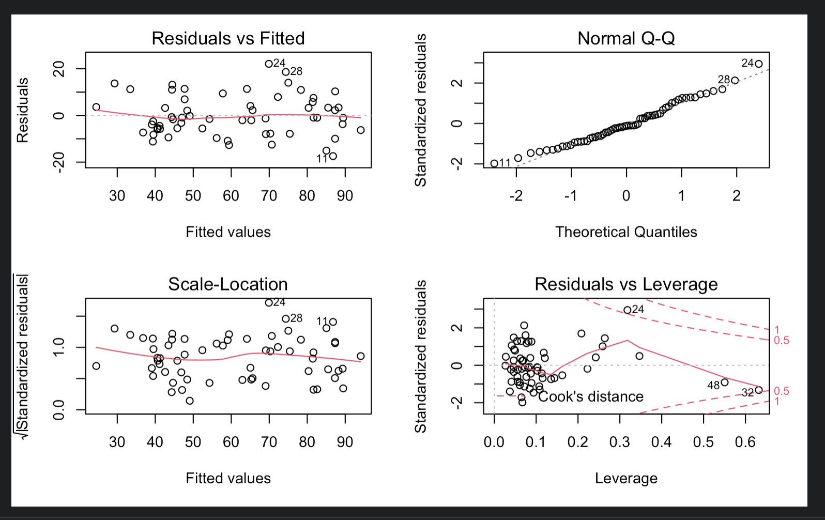
Model 4: Stock Prices and Airline Delays (cont’d)

Slide 23
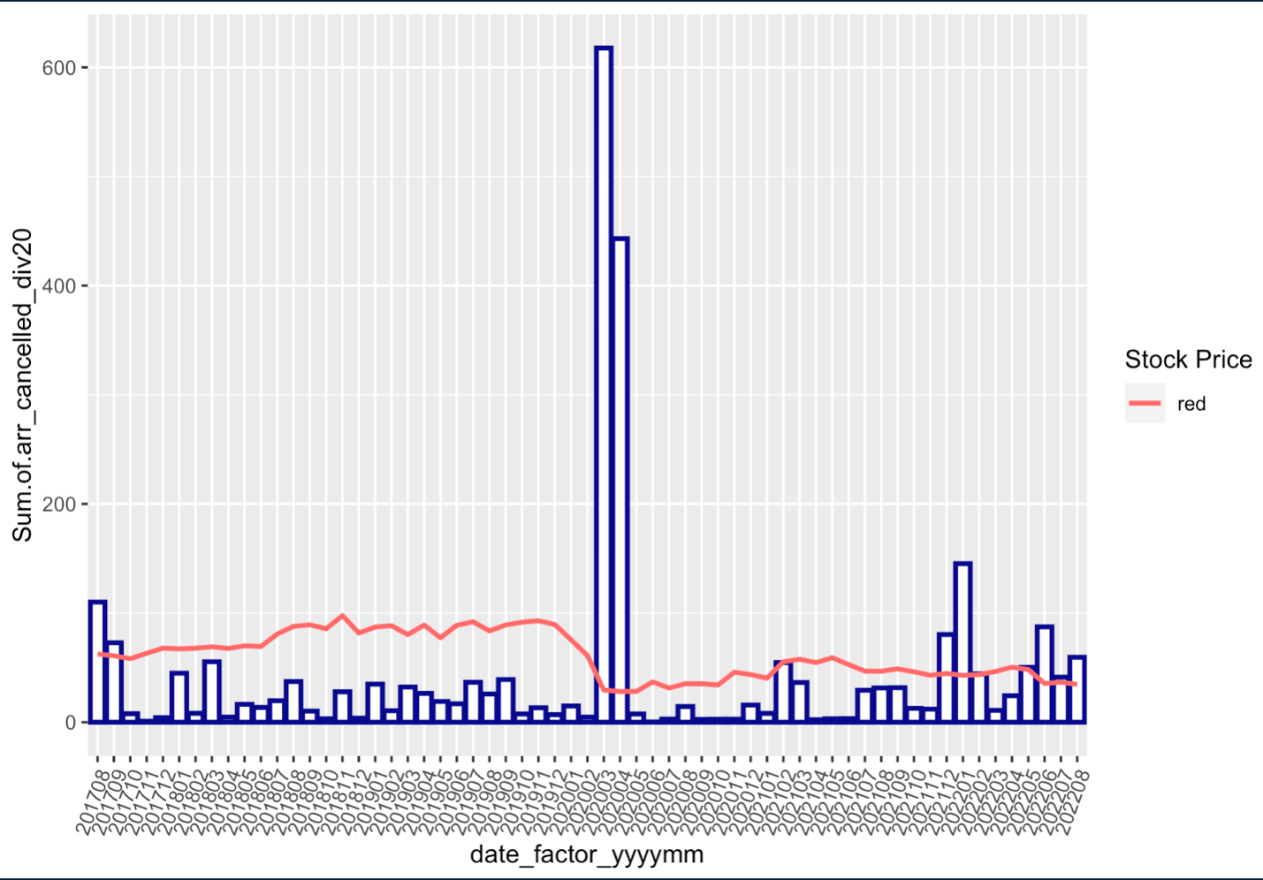
Model 4: Stock Prices and Airline Delays (cont’d)

Slide 24
Model 4: Take Aways
Large BTS data sets available – all monthly
Data is bifurcated
Flight count
Minutes late
Detail and aggregation for both types of data
Data dictionary difficult to find and more so, requires work to familiarize
Many models attempted
Complicated industry
Competition with national carriers
Required deliberateness from pilots and mechanics
Traders extensively study and use this type of data
Probably daily or even more granular
Probably purchased

Slide 25
Conclusion:
Do delays have a negative impact on Airline financial portfolios?
While we found some evidence for delays impacting Airline financials the results were limited to United Airlines and cancellations
Many additional models did not provide adequate results
The data available to the team was monthly aggregate data
Data that is at a daily or more granular level would be desirable
It would also be desirable to pursue United Airlines models with more granular data as a first effort in correlations of delays and financials, additional airlines considered after results from the United study.

Slide 26

Data Resources
Flight Data
https://www.transtats.bts.gov/ot_delay/OT_DelayCause1.asp?20=E2)
Finance Data
https://finance.yahoo.com/
Airlines.org
https://www.airlines.org/dataset/u-s-passenger-carrier-delay-costs/
Delay Cost:
https://news.berkeley.edu/2010/10/18/flight_delays/
Covid Impact:
https://www.icao.int/sustainability/Documents/Covid19/ICAO_coronavirus_Econ_Impact.pdf

Slide 27
Linear Regression Analysis for Gross Profit
Conclusion
The transformation has definitively improved the 3rd model
Normality assumption is still violated.
Implication of the Normality assumption violation is that the uncertainty in predicting the Gross Profit would be higher than estimated using this model.
The model might not contain as many significant factors to accurately predict Gross Profit.
Thus we conclude that weather delays alone does not statistically affect airlines Gross Profit

